Slide 1

Operation & Maintenance
Integrated Facility Management
Environment Management
RIMPL
Rainbow Integrated Multitech Pvt Ltd
- creating value through services

Slide 2
About us…
Rainbow integrated Multitech Pvt. Ltd., (RIMPL) is an ISO Certified, D&B Verified, NSIC & MSME certified company having turnover of USD 1.5 Million. An umbrella organization that brought together entities with rich experience in the areas of,
Operation & Maintenance of Process, Power plants and Manufacturing, etc.,
* Performance based Contract
* Service Linked Contracts
Electrical Solution (Earthing)
Manpower Management *Line Operation – Unskilled to Highly Skilled
*Maintenance Crew (MEP),
*Elite Security and Safety Personnel
*H/keeping & Other Manpower Outsourcing Solution
Environment Management Solid Waste Management Water, Waste water and Effluent Management as Turnkey Projects and O&M Services
People search for a highly professional & economical one roof Solutions company ends here.

Slide 3
Leadership Team…
K.VIJAYANAND
DCE., B.Tech., Chem. Engg.
DIRECTOR
2
R. SARAVANAN
B.Sc., M.A., B.L.,
DIRECTOR
1
K. NANDHAKUMAR
B.Sc., M.A., MBA PGDP&C, PhD
MANAGING DIRECTOR
Having more than 18 years of experience in Environmental Management and O&M
Successfully completed many EPC Projects in the area of Water/ Waste Water, Effluent Treatment and other Project Management Activities
Having more than Two Decades of Industrial Experience
Handled O&M, PMC, Construction, MEP projects etc domestic and Internationally.
Worked in Senior management level for TOP MNCs like Hyundai, Seoyon E-hwa, Quess Corp
Having more than Three decades of experience in Government and Private Sectors.
Expertise in Facility Mgmt. services with excellent liasoning skill.
Excellent Team with vertical Managers to manage O&M, EM & IFM

Slide 4
Leadership Background
Our Leadership has a vast experience in managing the Technical Human Resources, during his professional experience, in the following sectors:
Sector | Client | Plant Capacity | Projects Handled |  | Location | Crew Strength
 |  |  | Mechanical | Electrical
Cement | Chettinad Cements | 30MW CPP |  |  | Kallur Works, Karnataka | 110
 | Ultratech Cement | 30MW CPP |  |  | Chhattisgarh | 135
Mines | Hindustan Zinc | 1.2M Ton/Yr |  |  | Rajpura Dariba | 185
 | Vedanta Limited | 1M Ton/Yr |  |  | Lanjigarh, Odisha | 170
Metal | Essar Steels | 10M Ton/Yr |  |  | Visakhapatnam, Andhra Pradesh | 165
 | JSW | 18M Ton/Yr |  |  | Bellary, Karnataka | 155
Paper | JK Paper Mills | 55MW CPP |  |  | Rayagada, Odisha | 115
 | Sirpur Paper Mills | 40MW |  |  | Sirpur Telangana | 105

Slide 5
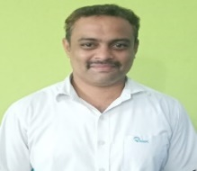
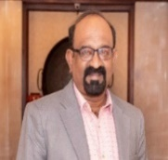
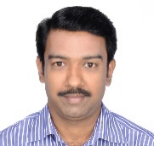
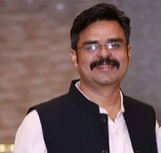
Regional Leaders…
Mr. Sivasubramanian
Project Head
Chennai
Mr.Saravanan
Industrial Safety
Mr. Jeyander
Manufacturing Specialist
Mr. Sanjit Kumar
MEP Specialist
Odisha
Mr. Suresh Kumar B Com
Manager - IFM
Chennai
Mr.Duraiswami B E
Manager – Operation
Chennai
Mr. Sivaji B Tecn, ME
Manager – EHS
Chennai
Mr.Raja Ram
Consultant – Operation
Chennai
Mr. Gowri Shankar B Tech
Manager - O&M
Rayagada - Odisha
Mr. Senthil Kumar B E
Manager - IFM
Anathapur, AP
Mr. Arevazhagun ME Instr
Manager – IT
Chennai
Mr. Nithyanda Dass
Consultant – HR
Odisha

Slide 6

Key Milestones
Present
Reached Turnover of 3.0m USD, having ISO 9001 certification
Having M/pwr strength of 400+ & with Group Companies strength of 1500+
Expanded to major states in the country (TN, AP, PD, OD & etc.,)
Involved in Operation & Maintenance and Safety Solutions
Providing Facility (MEP, H/Keeping & Security) & Environment Management Services (WTP, STP, ETP, Bio-Gas & Solid Waste Management)
2017
Expansion to AP and Odisha (JKPM/ TMEPL etc.,)
2015
Provided MEP Services in the brand name ‘Mr.Service’
2014
Collaborated with UNIFAC, a Facility Mgmt . Co.
2013
MOU signed with Guardian Integrated Security Services
2010
Developed a division to handle Civil & Environment O&M
2008
Established to provide Qlty M/pwr to Industries

Slide 7




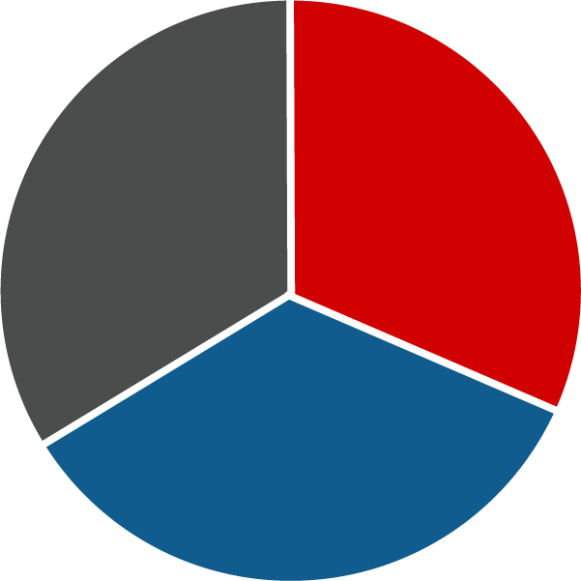





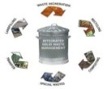




Our Services…
Housekeeping
WTP
STP
Landscaping
ETP
Mechanical
Integrated
Facility
Management
Environment
Management
Bio Gas Management
Electrical
Operation &
Maintenance
Plumbing
Solid Waste Management
Security
Engineering
Operation
Maintenance
Safety Support

Slide 8

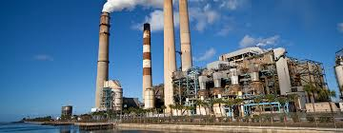
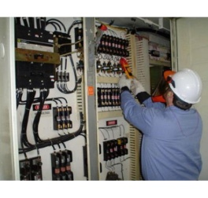
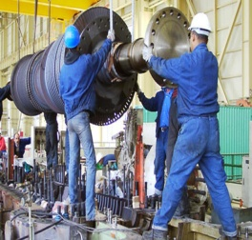
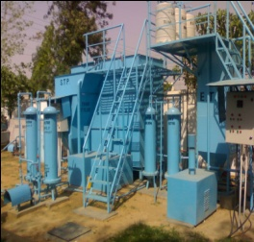
Operation & Maintenance
Maintenance
Operation
Energy
S No | Client Name | Projects | Plant Capacity
1 | JK Paper Mills | Operation & Maintenance of Lime Kiln and Pet coke Unit | 55MW CPP
2 | Sirpur Paper Mills | EPC and Maintenance of Transformers, panels and Motors | 40MW Co-Generation Thermal Power Plant
3 | Tata Meenakshi Energy Pvt. Ltd | Maintenance of Power Plant and EPC of Electrical Earthing | 2x150MW
4 | Utkal Alumina | Design and Erection of Piping System | 1.5 MTPA Alumina Refinery

Slide 9


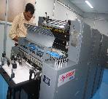
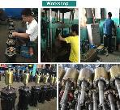
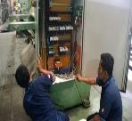
Engineering Service
Safety
Production
Quality
S No | Client Name | Projects | Industry Type
1 | SEOYON Automotive | Oragadam | Automotive
2 | Delphi Automotive | Oragadam | Electrical Components Manufacturing
3 | Sungwoo Hitech | AP | Automotive
4 | First Engineering | Irungattukotai | Plastic Process

Slide 10
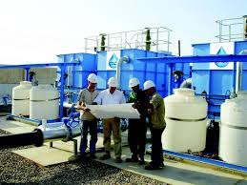
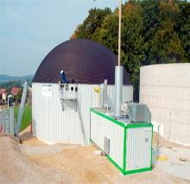
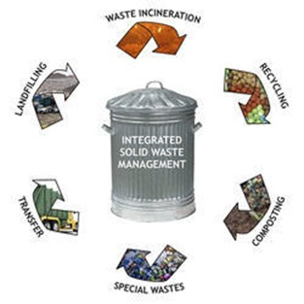
Environment Management
Solid Waste Management
Water & Waste Water Treatment
Bio Gas Plant Management
S No | Client Name | Location | Industry Type
1 | Mahindra World City | Chengalpet | Integrated Business City
2 | Yorozu JBM Automotive | Oragadam | Automotive Industry
3 | SL Lumax | TN/ AP | Automotive Industry
4 | Harita Fehrer Limited | Sriperumpudur | Automotive Industry
Operated & Maintained 10MLD of ETP / STP and
10 MT of Solid waste

Slide 11
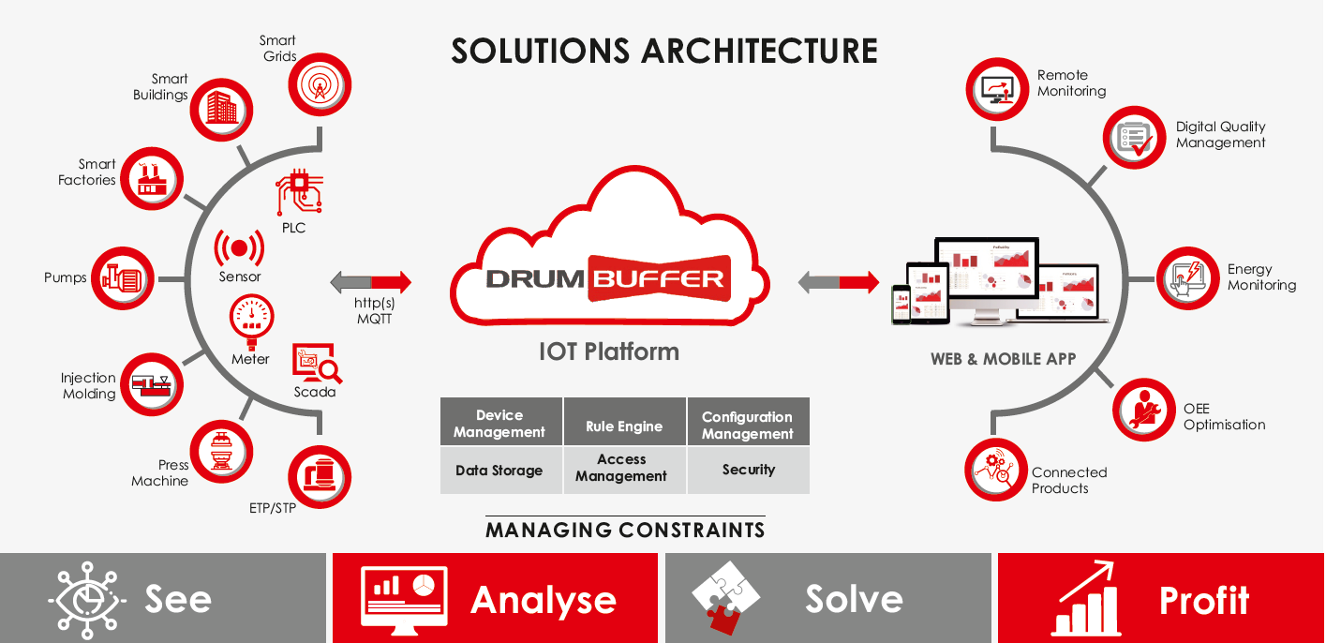





Maintenance Analytics
Implemented For Our Clients

Slide 12
Material Management System
Implemented For Our Client Eagle Burgmann India Pvt. Ltd
Our Value Proposition to Client
Standard On-Time Delivery
High Level accuracy in Ordering and Billing
Best Channel Design and network Strategy
Product wise Maintenance
Optimized Stacking and Retrieval
Developing Operational Excellence
Warehouse Management
Implementing Best Solution
Information System
Procedures
Material Management
Sales Forecasting
Transportation Management
Equipments
Policies

Slide 13
Integrated Facility Management
INTEGRATED FACILITY MANAGEMENT
ELECTRICAL
BMS
HOUSE KEEPING
SECURITY
MEP
LANDSCAPE
S No | Client Name | Location | Industry Type | Nature of Work
1 | Eagle Burgmann KE | Chennai | Mechanical Sealing Solutions Industry | Integrated Facility Management
2 | ISRO (MRPU) | Chennai | Government of India Corporate Office | House Keeping and Data Management
3 | SVDC | Chennai | Hospital | House Keeping and Maintenance
4 | Casa Grande (ROA) | Sriperumbudur | Gated Community | House Keeping and Operation & Maintenance (MEP services)
5 | Accudyne (MR) | MWC | Manufacturing Industries | Facility Management

Slide 14
Integrated Facility Management
Mechanical
Industry
Facility Management Service
Hard Service
Gated Community
Malls
Hospital
Hotels
BMS
Lift Maintenance
DG & Lift Maintenance
Electrical & Plumbing works
Managing more than 50lakhs Sq.Ft

Slide 15

Integrated Security Service
SECUERO
ELITE GUARD
ARMED GUARD
BGV
BODYGUARDS
S No | Client Name | Location | Industry Type | Nature of Work
1 | Russian Embassy | Chennai | Russian Consulate | Elite Security Personnel
2 | Uber India | Chennai | Customer Service | Parking Yard Management
3 | Headstream India | Chennai | IT Service | Employee Security
4 | PBV | Chennai | Gated Community | Common Gate Keeping
5 | Sangeetha Hotels | Chennai | Hotel | Warehouse Management

Slide 16






Why RIMPL
UMBRELLA SERVICE
Under one roof, providing complete solution to our clients in various discipline
OFFSHORE SITE MANAGEMENT
Dedicated pool of resources, Managed by expertise leadership
MACHINE MONITORING SYSTEM - DRUM BUFFER IOT PLATFORM
Specialist approach in Equipment & Machinery Maintenance by implementing Manufacturing
Analytics system
TRAINING & SKILL DEVELOPMENT
SMEs will be deployed in case of specific T&D support at Client premises with our exclusive pool of SME consultants
VALUE ADDED SERVICE
100% Employees are covered with Group Insurance (GTLI)
STATUTORY COMPLIANCE
ISO 9001 company,
100% compliance in statutory, Tax and environmental regulations
CASE IN POINT
100%
Enduring relationships with clients by
providing end to end services
Customer Satisfaction - Converted 35 Yrs of Manual Cleaning method of Furnace bed & Pent House into Automation in JKPM, Odhisa – Power Plant Maintenance
10+ years
Decades of engagements

Slide 17
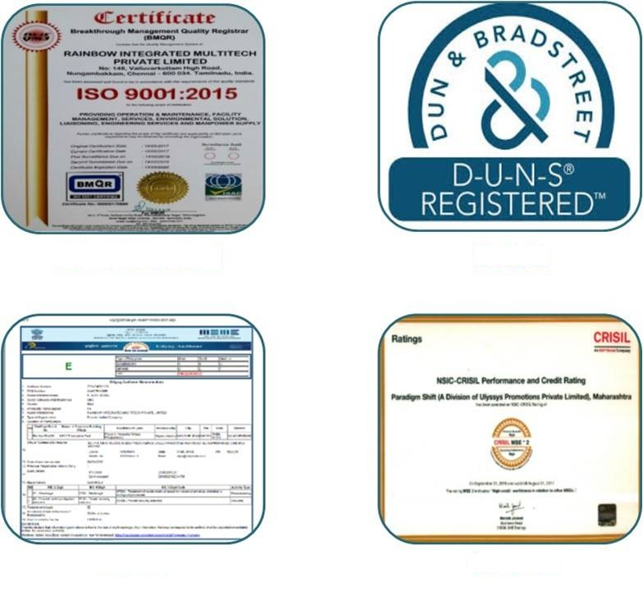
Credentials

Slide 18
















Clientele….

Slide 19
Contact us
RIMPL, with its industry experience, an established business network and with an entrepreneurial foresight, is well positioned to take advantage of the additional opportunities expected in the growing Industrial revolution.
Contact Info
Mail ID : projects@rimplasia.com
Phone : +91 9841337626 / 8939944416
044 30073007 / 044 42107111
Website : www.rimplasia.com
Corporate Office-TN
Rainbow Integrated Multitech Pvt Lt
C-44, II Floor, C-Block, 7th Street,
Annanagar East, Chennai – 600102.
Ph:+91 99454 35507
Regional Office - AP
Rainbow Integrated Multitech Pvt Ltd Address: No:1-243-28, New Colony, Madakasira Road, Penukonda-515101. Ph:+91 93444 12333
Regional Office - Odisha
Rainbow Integrated Multitech Pvt Ltd Plot No -112, Bhagbanpur, Patrapada,
Bhubaneswar-19, Odisha
Ph:+91 77520 20890

